Slide 1
Downloading Jenkins and set up selenium grid
To download Jenkins as standalone application or as stand alone server in VM.
Pre-requisites are:
1) Ubuntu VM with behat and java installed in it
2) Win7 mahcine required as Vm host.
3) java JDK 7 and jre 7 installed and PATH variable set to proper locations on both machines
4) jenkins installed as server on VM(version 1.515))
5) jenkins selenium plug in
1) We need to follow instructions as listed on
https://wiki.jenkins-ci.org/display/JENKINS/Installing+Jenkins+on+Ubuntu
after installation is complete
OR
Simply follow instructions by clicking on particular OS icon on http://jenkins-ci.org/
2) After installation please check if Jenkins is running or not.
http://localhost:8080/ in your windows/Unbuntu machine.
For this demo complete set up of Jenkins in done Ubuntu VM.

Slide 2
3) We need selenium standalone jar copied in both the machines.
Path for latest selenium jar files. http://code.google.com/p/selenium/downloads/list
get last built version of selenium standalone jar file.
4) For sake of just exploring Behat with selenium facebook driver is installed on
Ubuntu VM, because it is easier to install with just some commands.
5) The above mentioned two machines will be configured as Master- slave configuration as mentinoed in here.
https://wiki.jenkins-ci.org/display/JENKINS/Step+by+step+guide+to+set+up+master+and+slave+machines
Why this configuration ?
We generally work with selenium grid2 when it comes to regression testing of web projects on multiple browsers across multiple OS.
For that purpose we need physical machine to set up grid hub and node network need to be modeled in Jenkins.

Slide 3
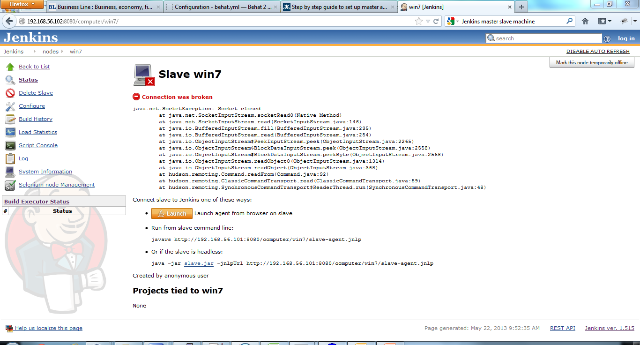
Setting up master slave machine in Jenkins
After following steps mentioned in https://wiki.jenkins-ci.org/display/JENKINS/Step+by+step+guide+to+set+up+master+and+slave+machines
Type jenkins server url in slave machine using firefox browser/or any of choice.
Go to Manage Jenkins-> Manage Nodes link
Click on Launch java button and proceed .

Slide 4
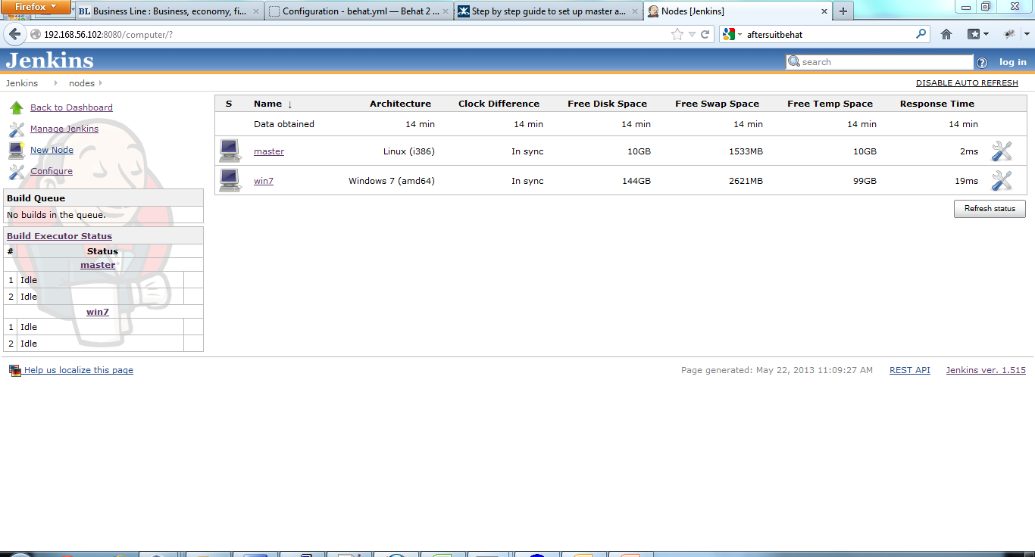
Or you can execute this command java -jar slave.jar -jnlp Url
http://192.168.56.102:8080/computer/win7/slave-agent.jnlp from command line
Change ip address to your Jenkins server installed in here.
once the command run successfully, you should be able to see master and slave connected as shown below.
Master machine here represents Ubuntu machine and slave is Win7.

Slide 5
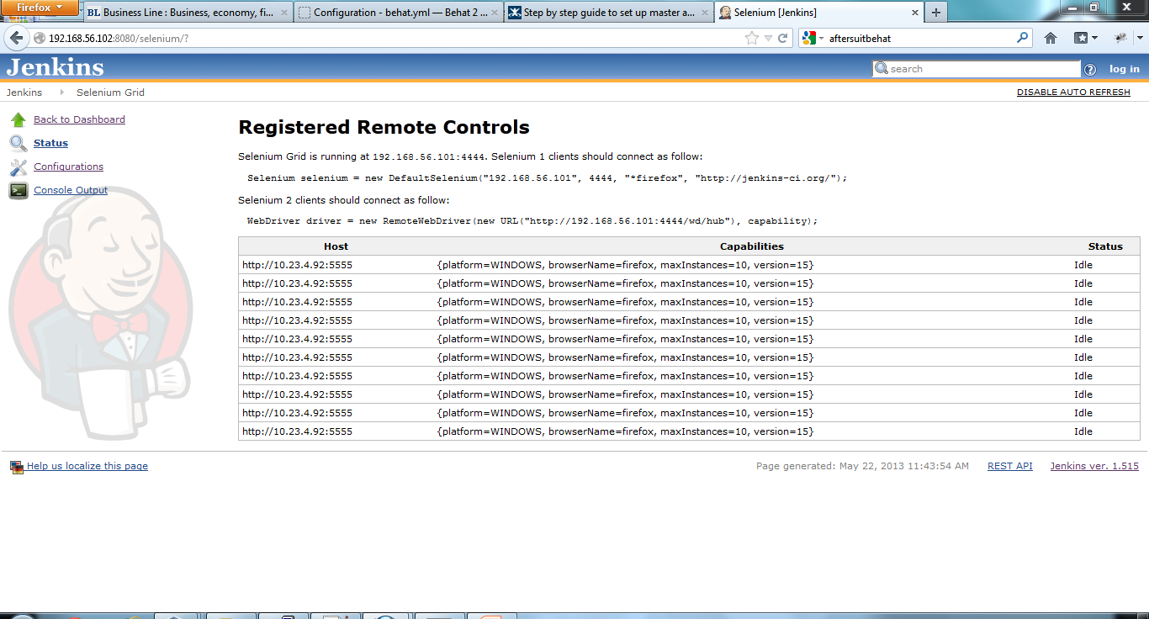
Selenium grid in Jenkins
After installtion of selenium plug-in from https://wiki.jenkins-ci.org/display/JENKINS/Selenium+Plugin or from manage plug-in page of Jenkins search for selenium plug and install as per instructions
Once installed , you can selenium grid is continuously running as shown in below screen.
We need to run the selenium grid node either separately from Win7 machine or you can create a another job tied to Jenkins slave.

